Slide 1
Bottom Up
The perspective from an engineering intern on the product, management, and the culture

Slide 2
A brief introduction about yourself.
Born in Chicago area
Lived in Hungary for 10 years
Moved to Houston, TX at the age of 14
Came to OSU in 2020
Graduating May 2024
I want to pursue a Masters Degree in ECE

Slide 3


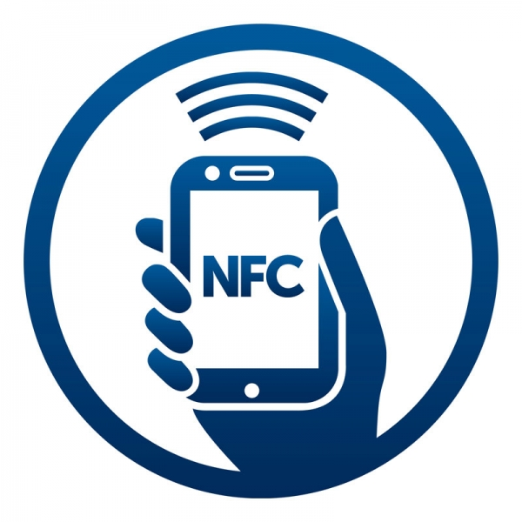
Information regarding your project(s)
Locator
Transmitter
Current Distance: 1500ft
Pipe
Setting up the communication link between the two devices can be finicky
What if we could just tap the transmitter and receiver together?

Slide 4


Explain the business value
Current product range: 2400ft
New testing range: 13200ft
LoRa protocol used in Smart Cities
NFC tap allows for less user error

Slide 5

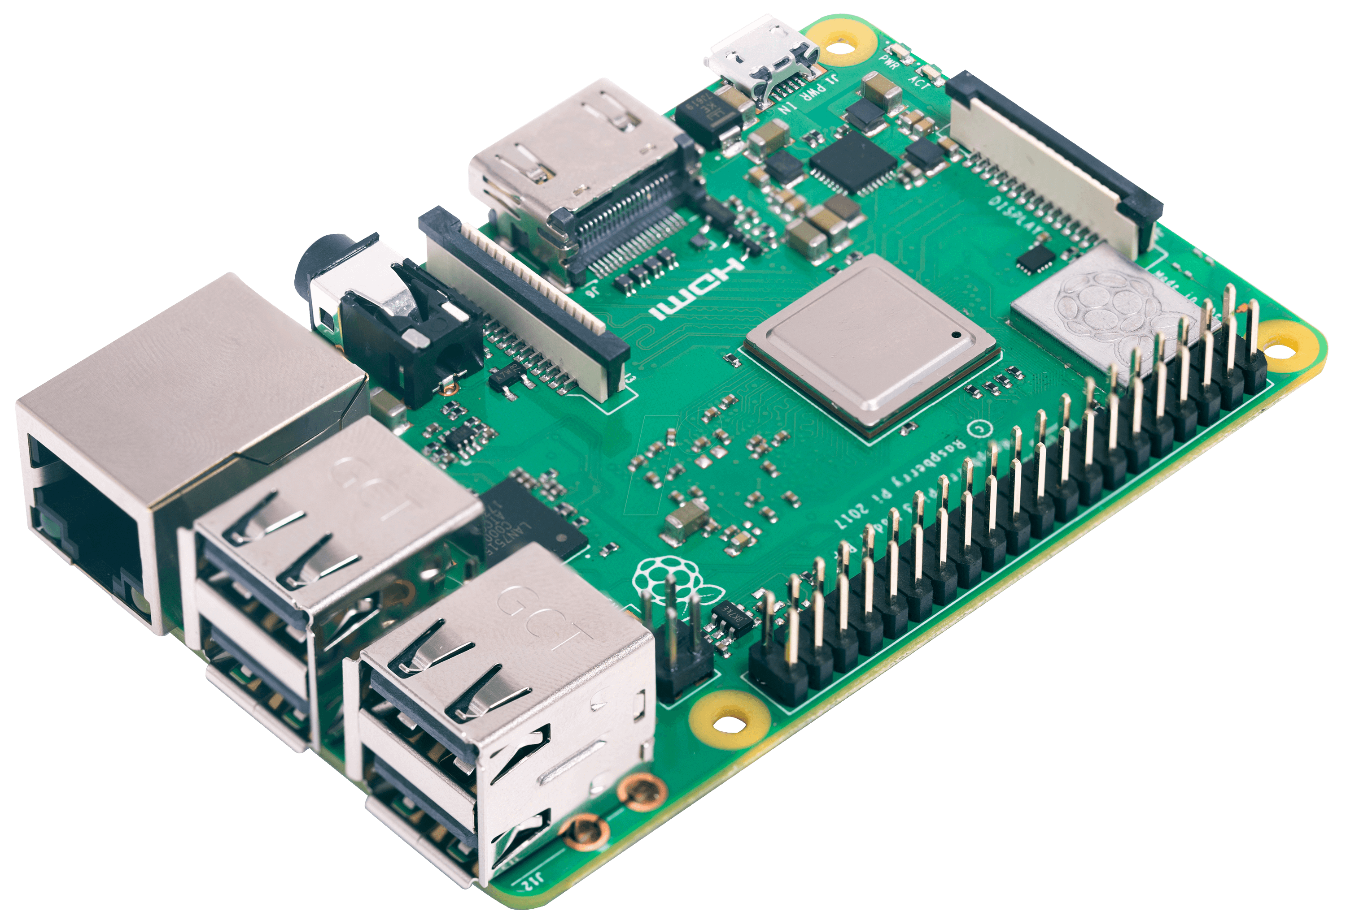
The work you did on the project
Used python programming to interface with the module
Migrated our code to a Raspberry Pi
Conducted range testing with varying antennas
Used python to test a NFC chip for contactless communication

Slide 6
What you learned from the project
Technical Skills
Soft Skills
Object Oriented Programming
Low level development
Version Control using git and azure cloud
Ask as many questions as you can to learn a wide perspective
Designing something takes longer than I thought
Creating documentation

Slide 7

What if any obstacles did you have to overcome?
Lack of knowledge
Deciding what colors to use on this presentation
Programming architecture
People have different motives and perspectives
Time

Slide 8
Overall experience with Ditch Witch
Pros
Cons
Hands on project
Independent work
Great team and mentoring
Fun events
I feel welcomed to ask questions
More product explanation
More intern events
More diverse learning about the company. Not just engineering

Slide 9
Sources
https://clipground.com/clipart-radio-waves.html

